Slide 1
Store management
BY:
GAUTHAM A.S
KARTHIK RAO
MITHUN
SHASHANK K

Slide 2
OVERIEW
The store management system is a web based management system. It maintains a database consisting details about products, supplier, customers, employees, storehouse , departments , daily transaction.
The Store Management System facilitates in the process of billing when the customer makes a purchase. It maintains an inventory which is automatically updated when a product is sold, returned or supplied from the manufacturer.
The Store Management System also generates a detailed analysis, which helps the manager of a particular department to take appropriate actions based on the analysis.
All the data is maintained over a local server. The employees can access the system by using their credentials. The users can access the website with their user id and password. In this way security for the system is maintained and appropriate features are given to the respective groups.

Slide 3
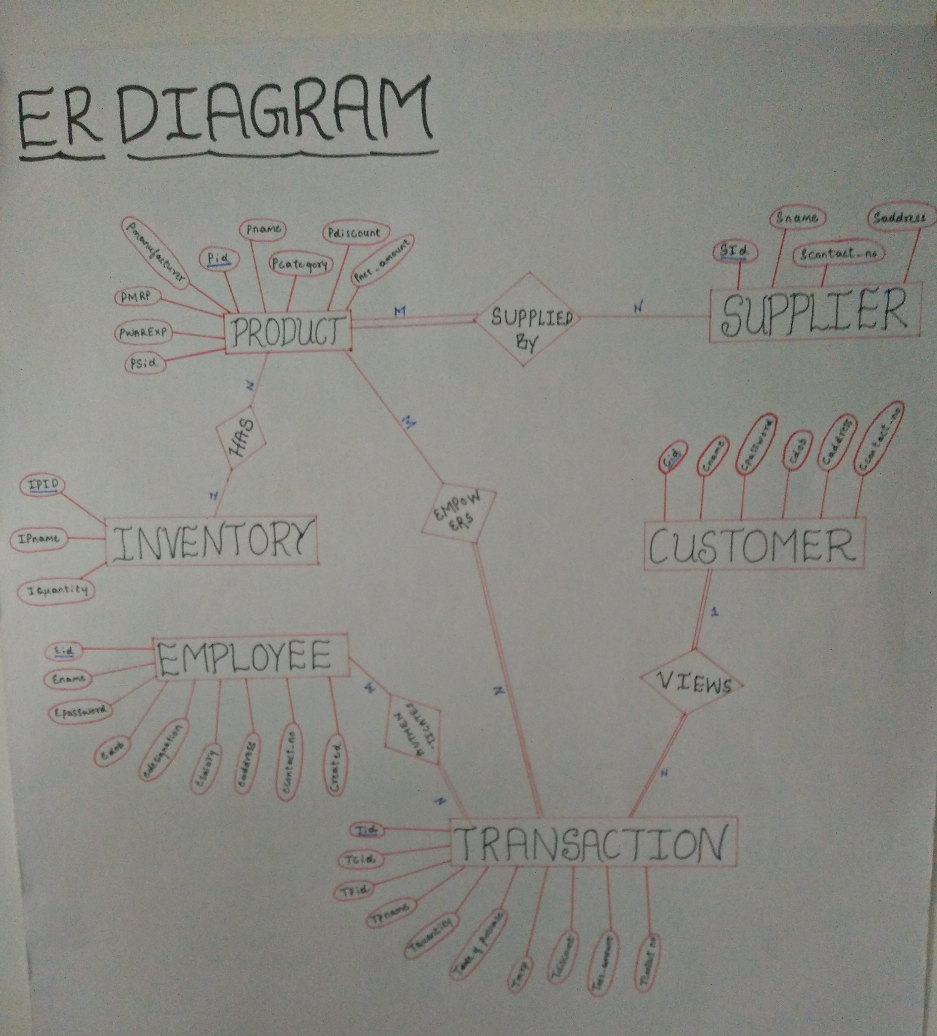
ER diagram

Slide 4
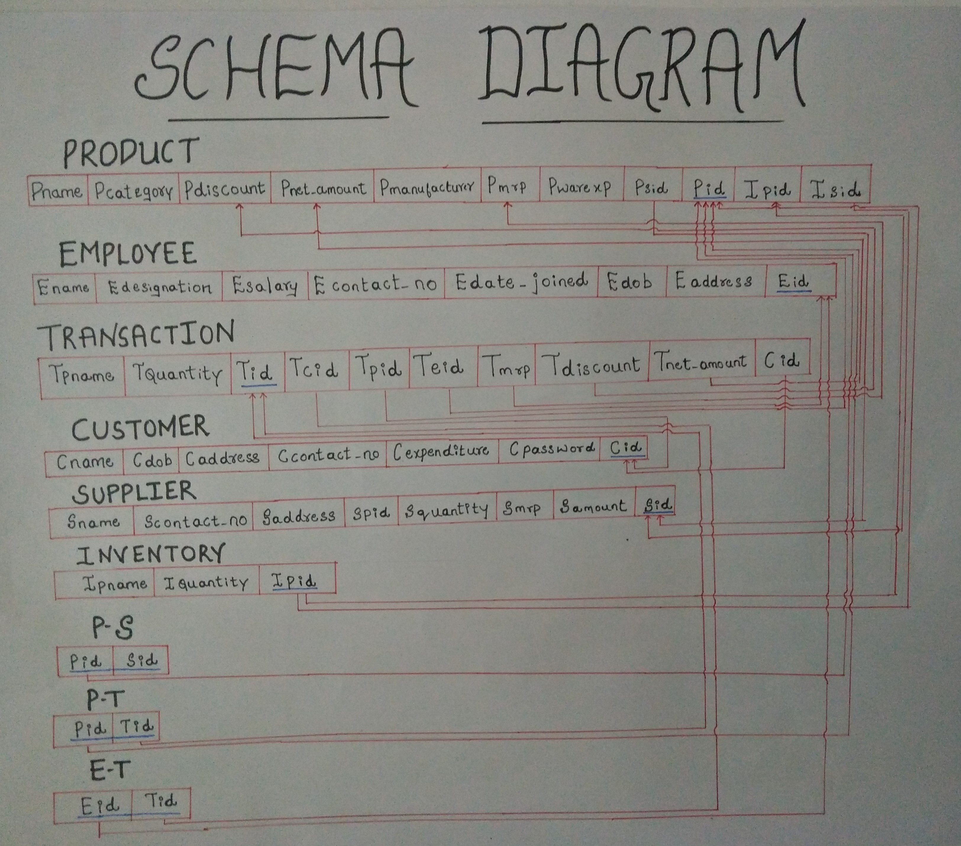
Schema diagram

Slide 5
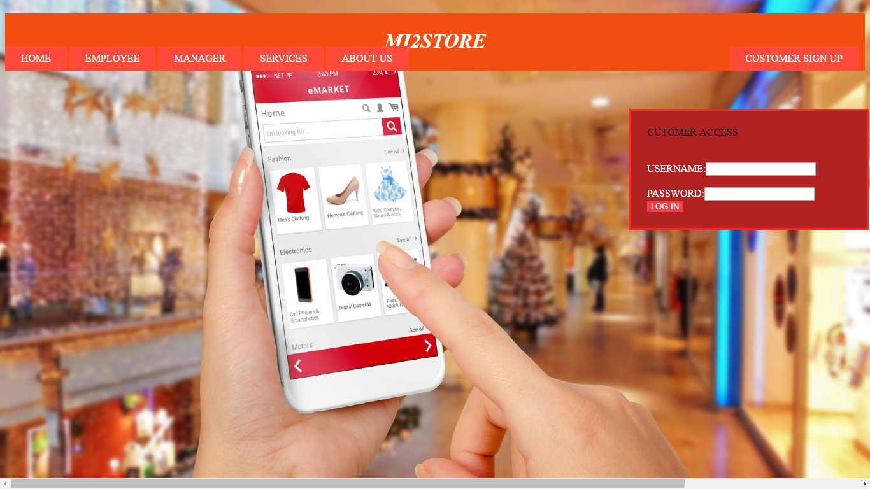
Home page

Slide 6
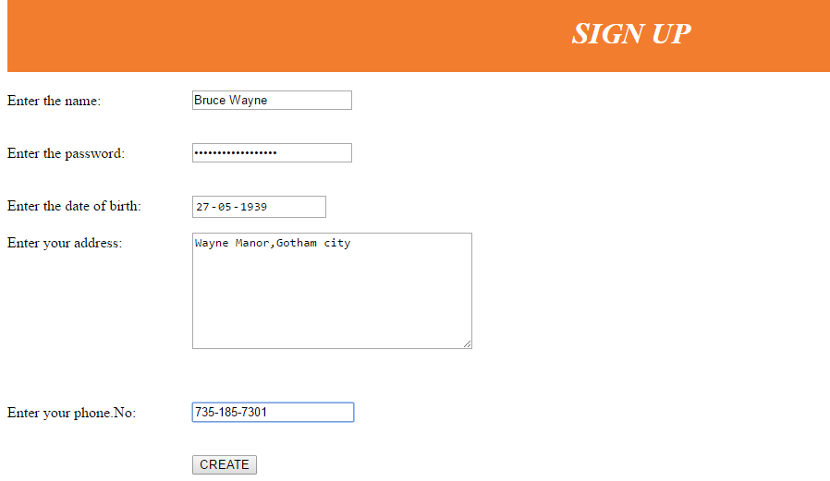
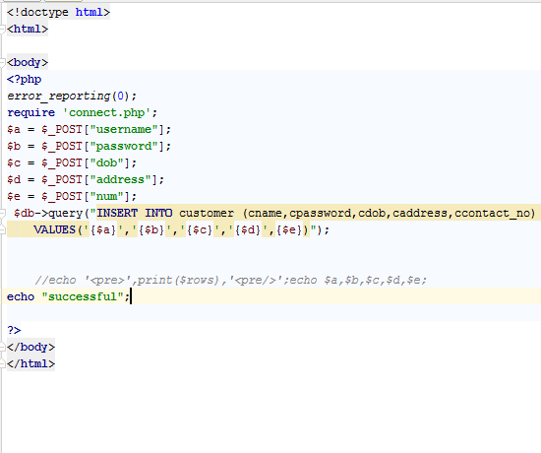
CUSTOMER SIGN UP

Slide 7
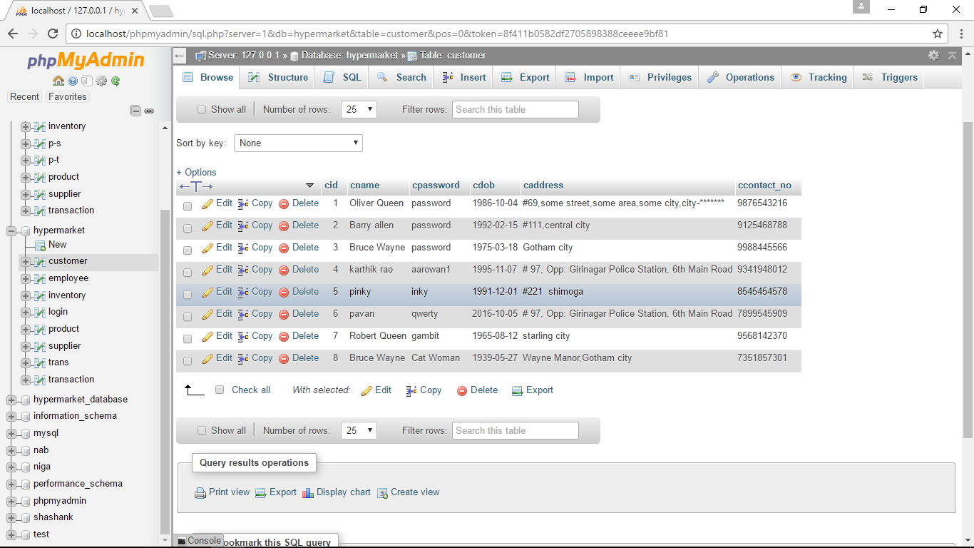
Customer updated

Slide 8
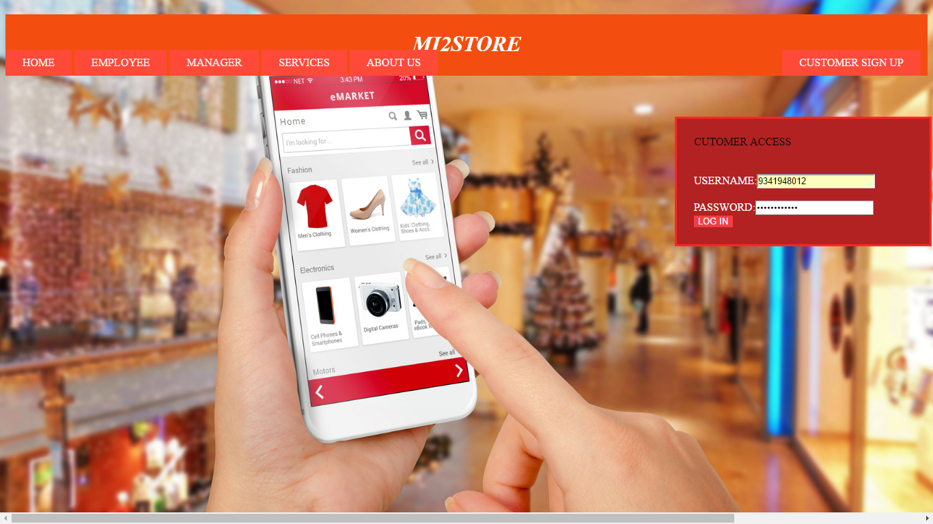
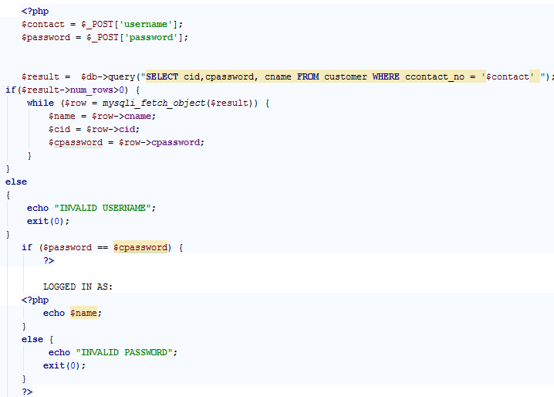
CUSTOMER LOGIN

Slide 9
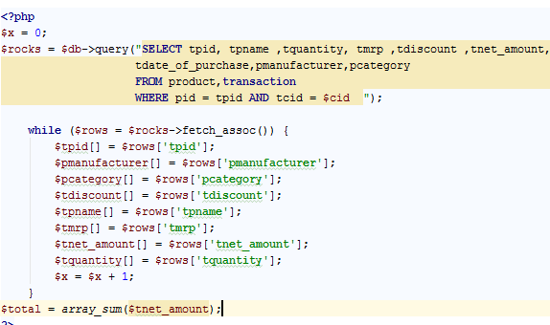
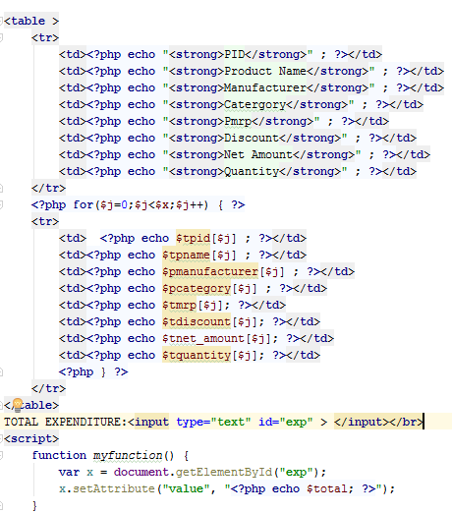
Query to show all the purchases made by a particular customer

Slide 10
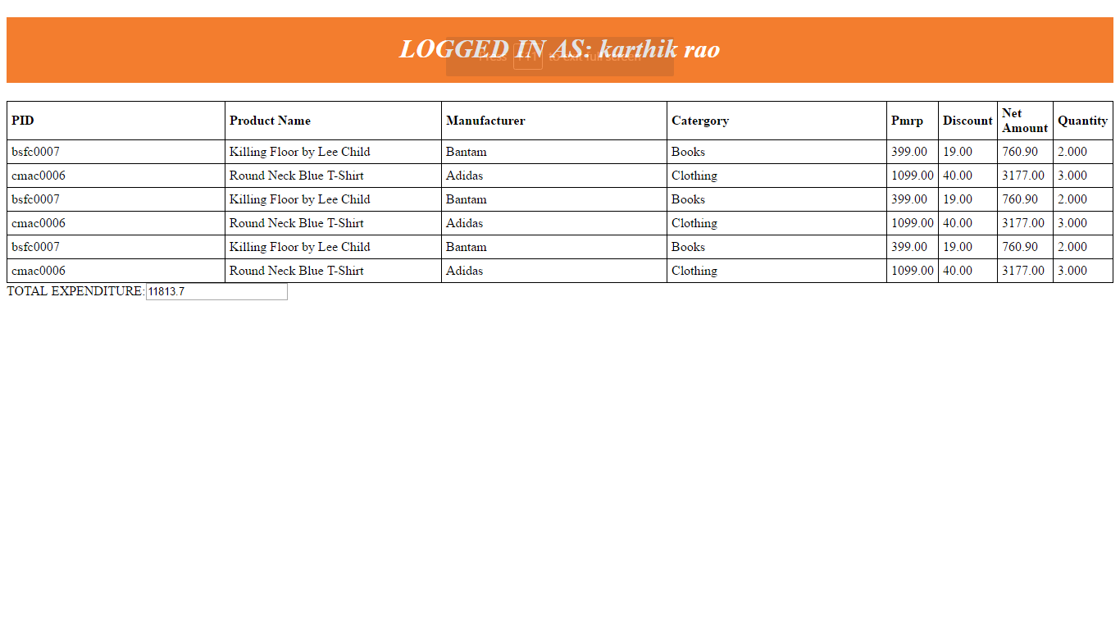

CUSTOMER PORTAL

Slide 11
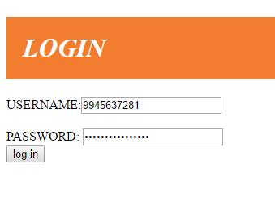
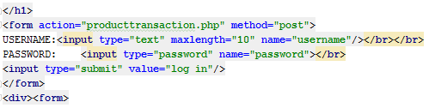
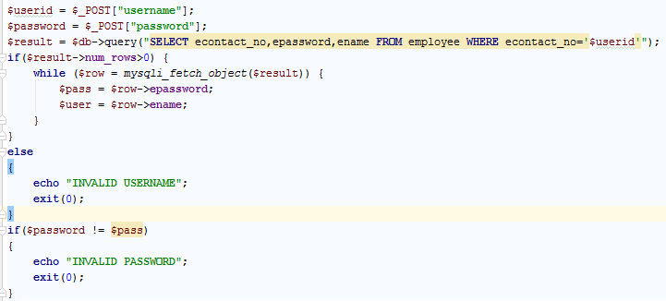
Employee login

Slide 12
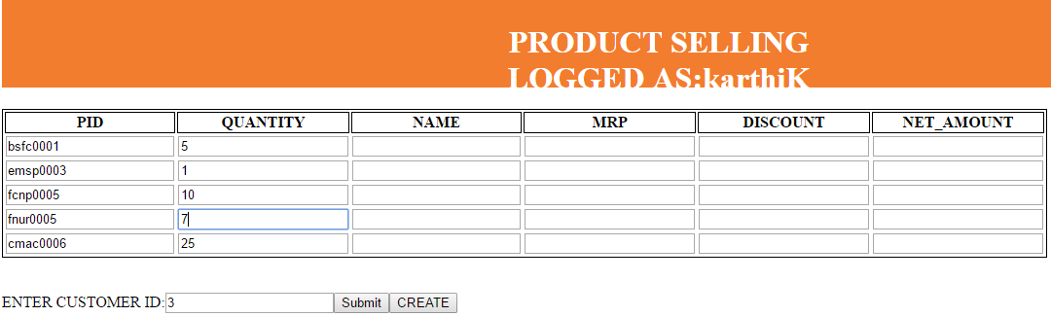
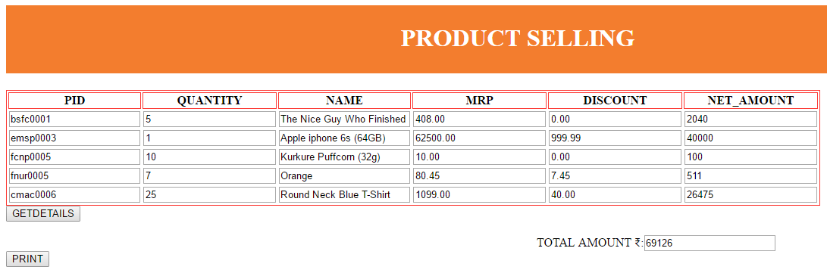

Transaction

Slide 13
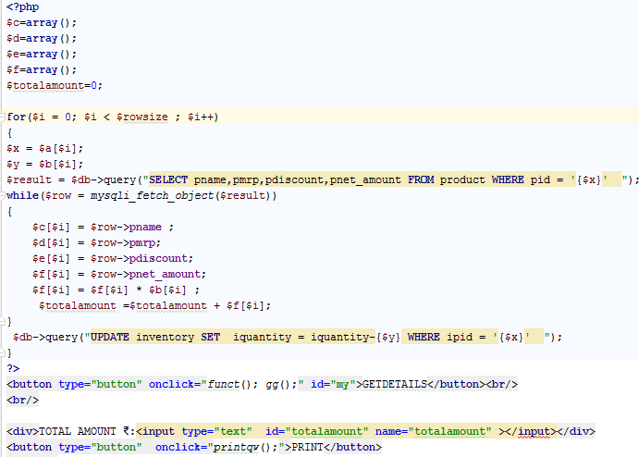
Queries to update inventory table when a purchase is made

Slide 14
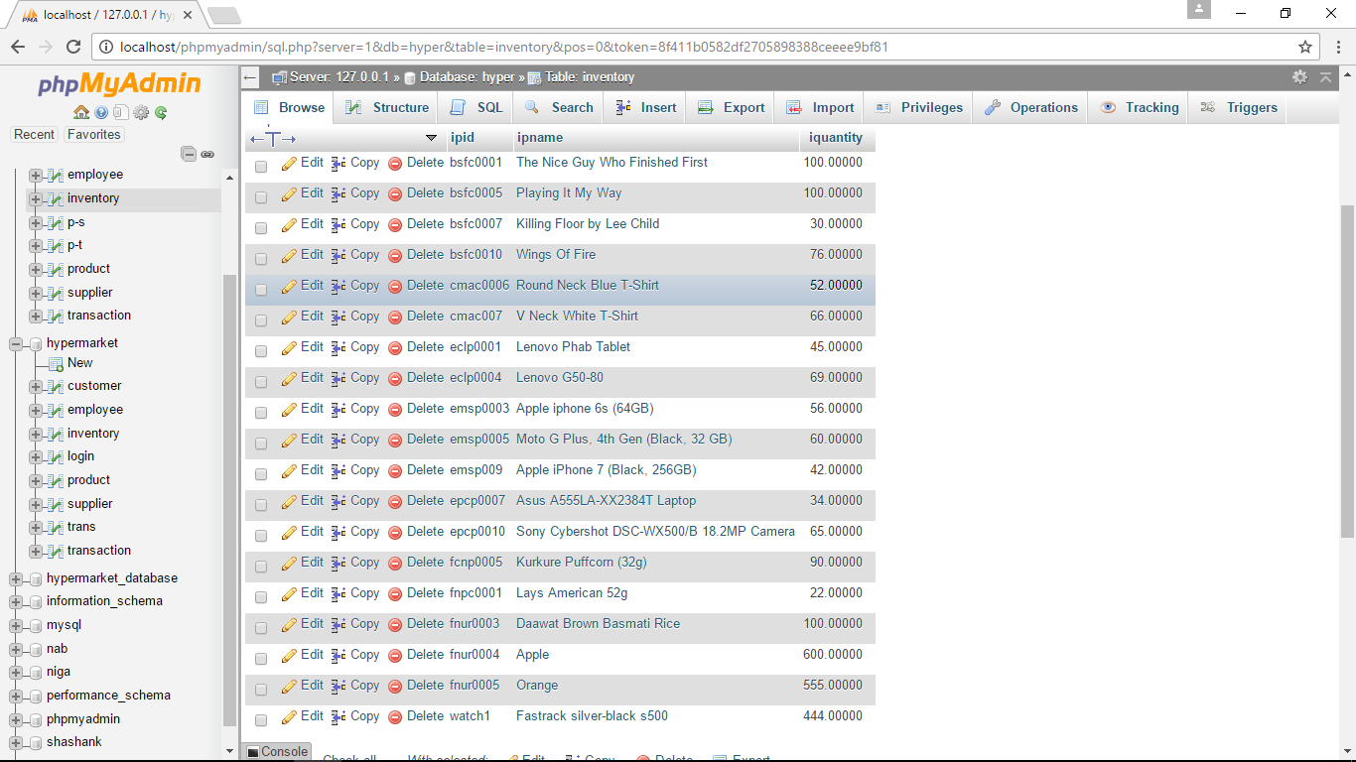
Updated inventory

Slide 15
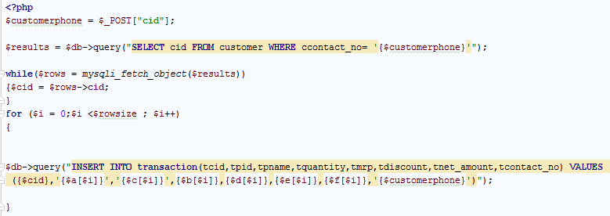
Query to update the transaction table when a purchase is made

Slide 16
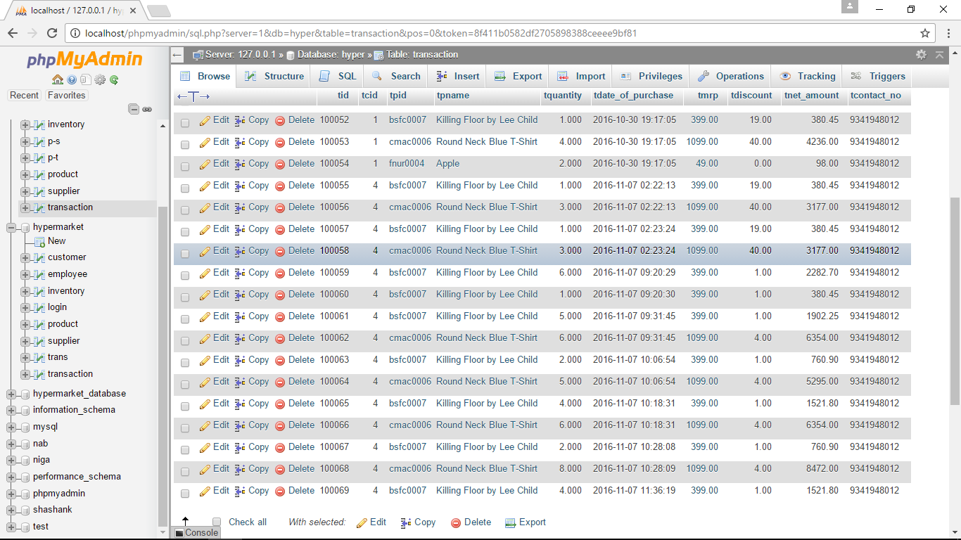
Updated transaction table

Slide 17
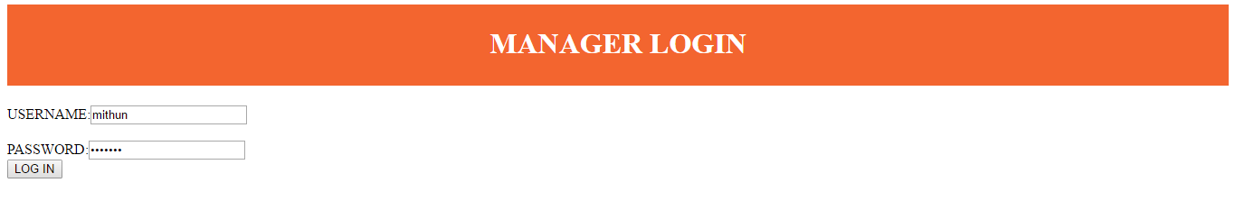
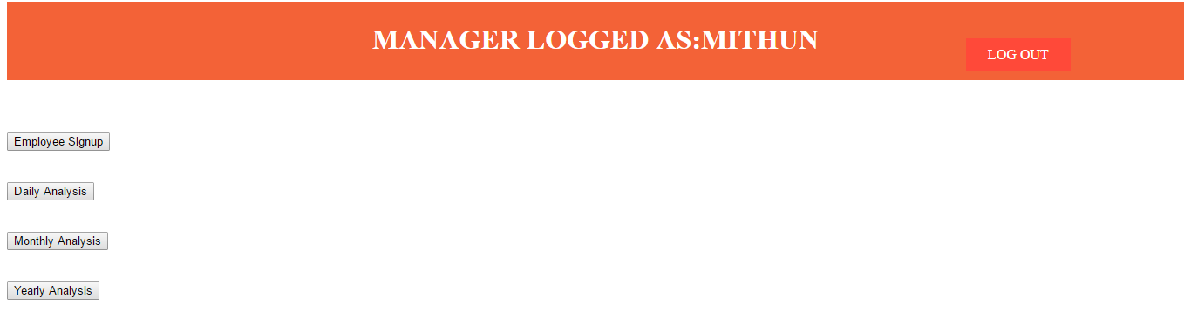
MANAGER PORTAL

Slide 18
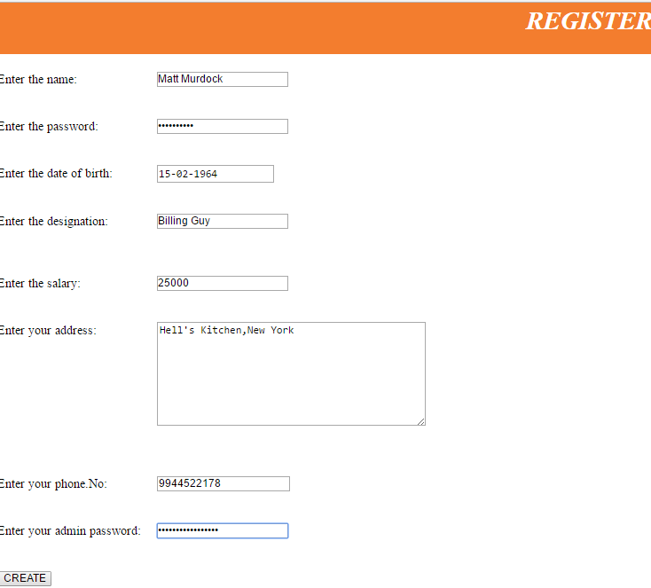
EMPLOYEE CREATION

Slide 19
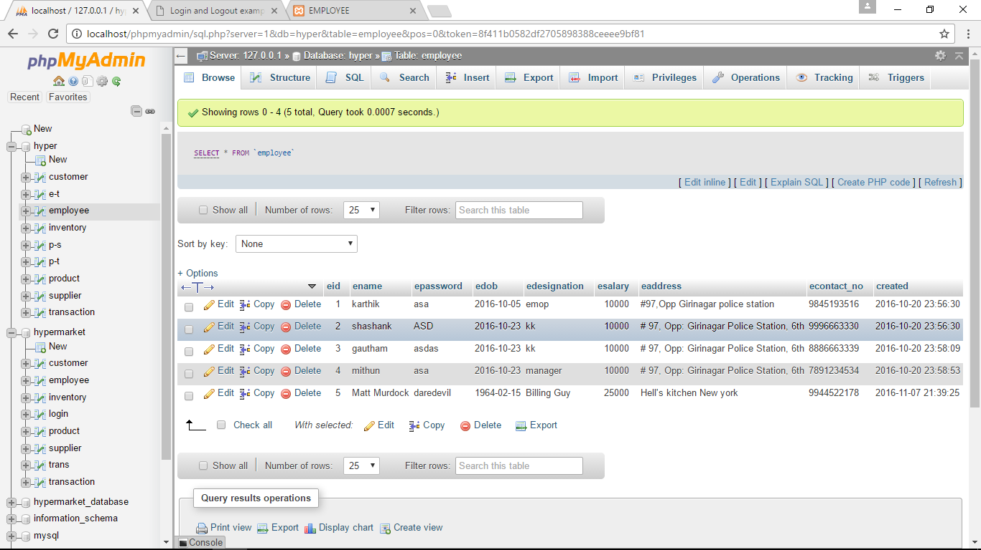
EMPLOYEE DETAILS INSERTED

Slide 20
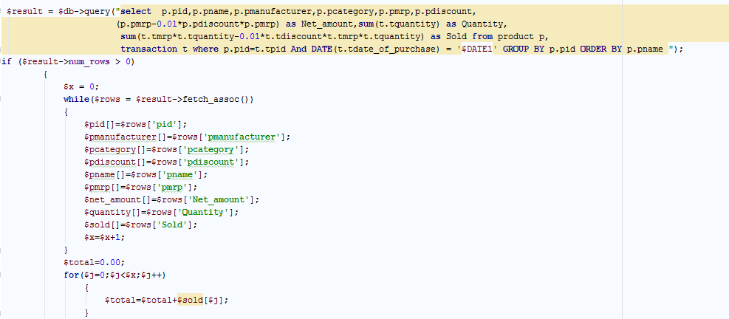
Query to perform DAILY ANALYSIS

Slide 21
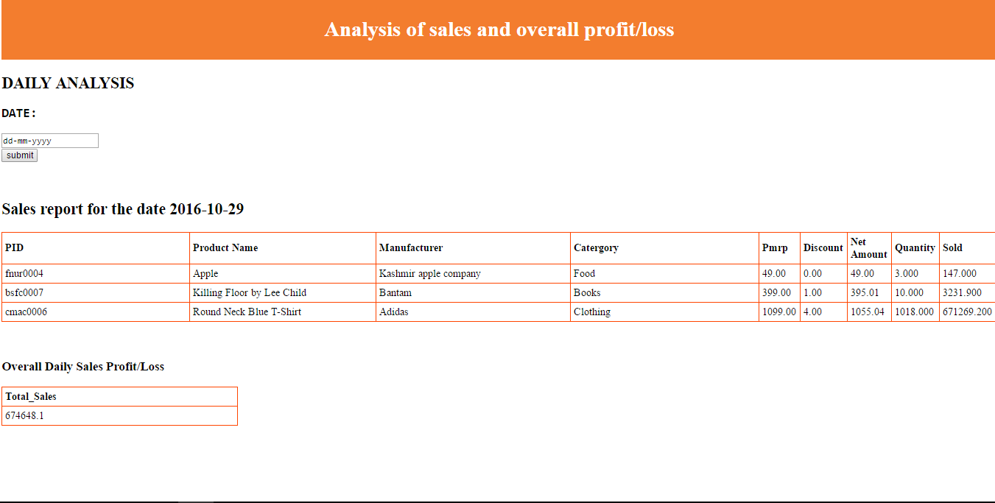

Slide 22
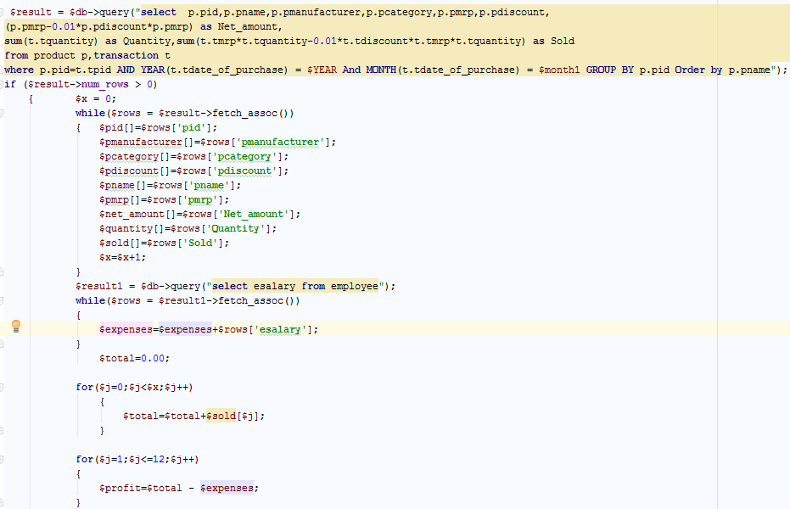
Query to perform monthly analysis

Slide 23
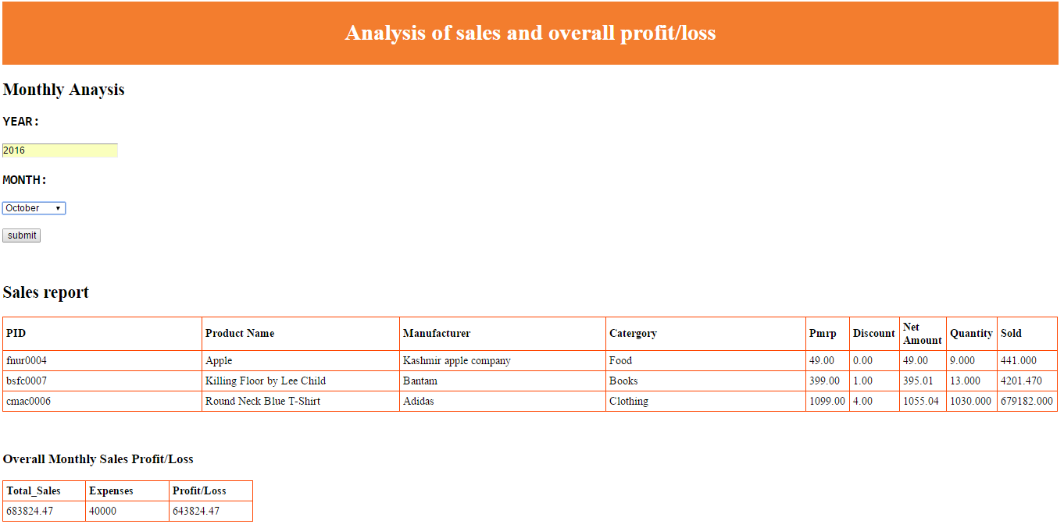

Slide 24
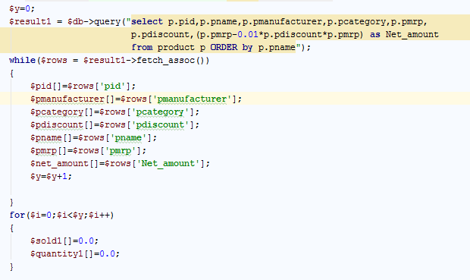
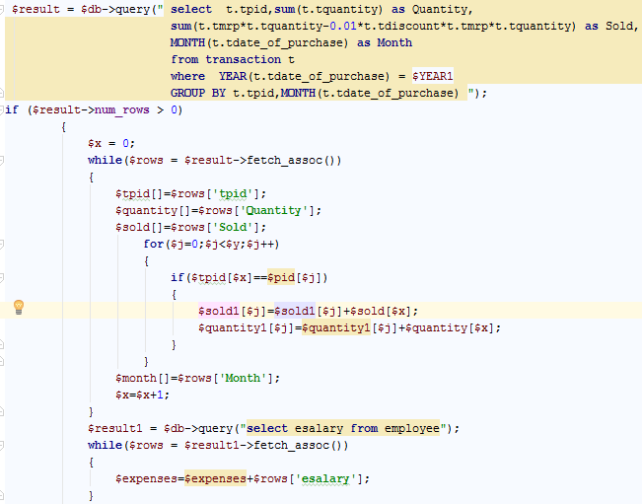
Query to perform yearly analysis

Slide 25
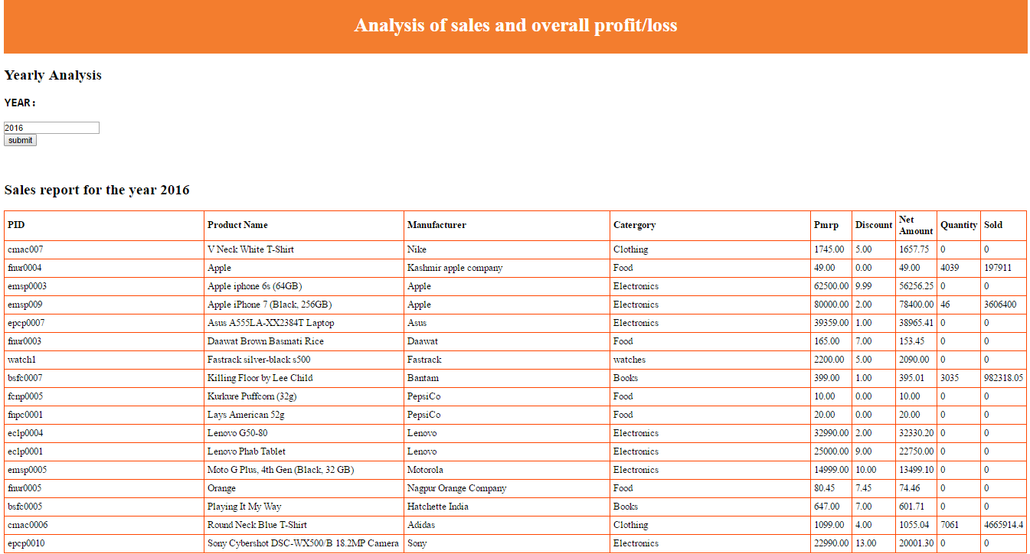

Slide 26
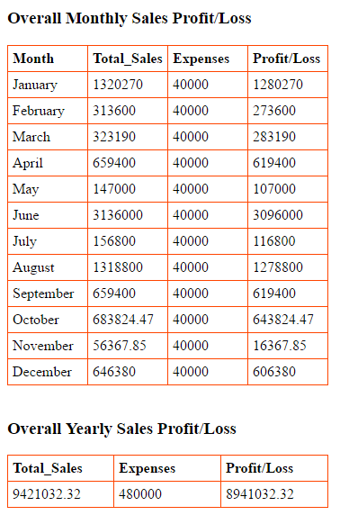

Slide 27
YEARLY PROFIT GRAPH

Slide 28
Thank you

